Slide 1

BRACT‘s
Vishwakarma Institute of Information Technology, kondhwa(BK), Pune-48
Department of Computer Engineering
BTech Final Year Project
FTR-3
Project Advisor
Innobytes Indutry
Sir Sachin deshpande
Presented to Final year project committee Department of Computer Engineering
Guided by prof. S.R.Rathi
Year 2022-23

Slide 2
Group Members
Sr. No. | Name | Roll Number | GR Number
1 | Prerana Karande | 422080 | 22020235
2 | Tanvi Patil | 424075 | 22020282
3 | Preeti Alegaonkar | 421081 | 22020292
4 | Sakshi Abnave | 422076 | 22020057
5 | Payas Sawane | 422057 | 21910807

Slide 3
Presentation Flow
INTRODUCTION
LITERATURE SURVEY
AIM OF PROJECT
PROBLEM STATEMENT
OBJECTIVES
PROJECT PLANNING
PRODUCT PERSPECTIVE:
PROJECT WORKFLOW
ARCHIETECTURE DIAGRAM/BLOCK DIAGRAM OF YOUR SYSTEM
DESIGN DIGRAMS FOR YOUR PROJECT
NEED OF YOUR SYSTEM
ALGORITHMS
TECH STACK DETAILS
DATA ANALYSIS: DATASET
REQUIREMENTS ANALYSIS : SOFTWARE & HARDWARE REQUIREMENTS
IMPLEMENTATION DETAILS
RESULTS
APPLICATIONS
CONCLUSION
FUTURE ENHANCEMENTS
REFERENCES

Slide 4
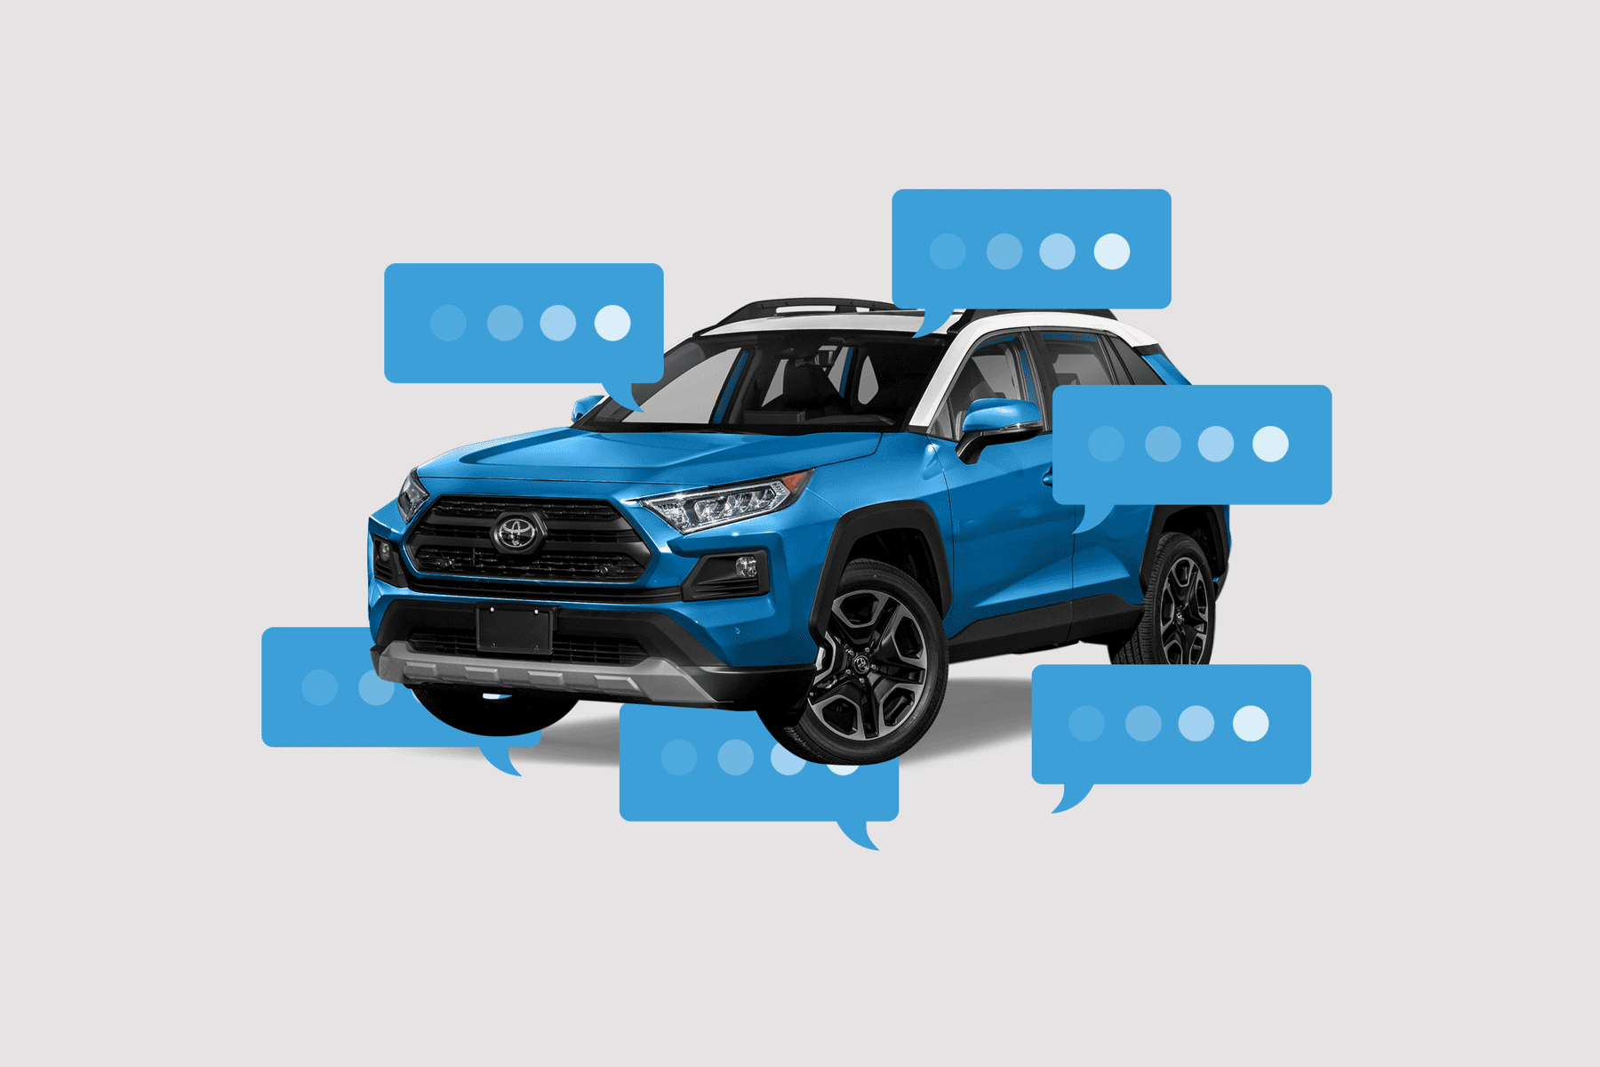

Slide 5
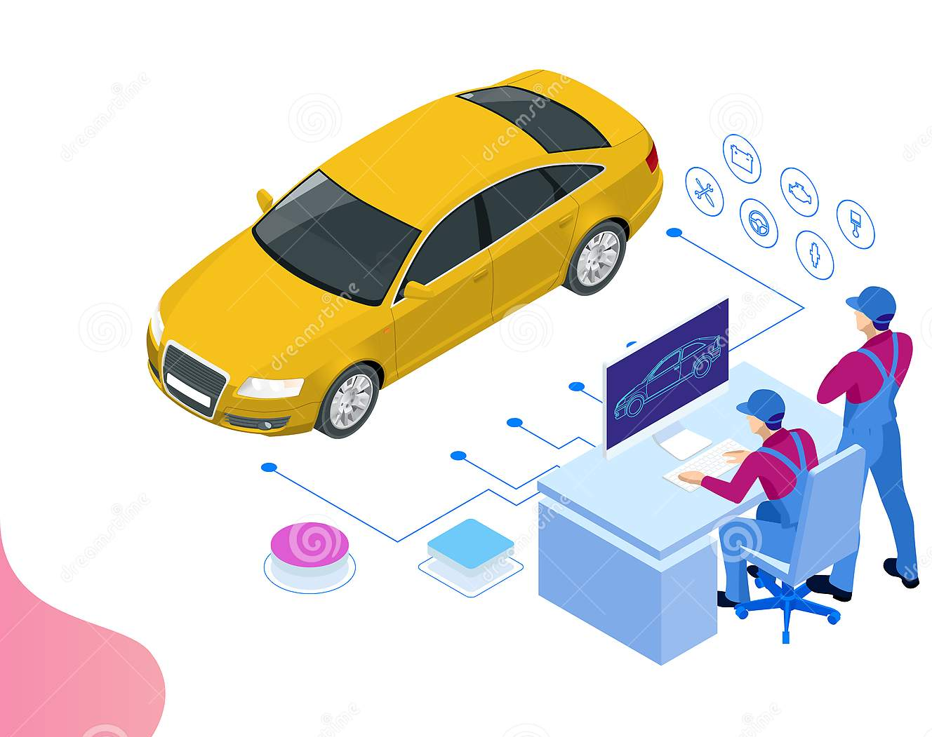
Title
Quality Auto Services

Slide 6

Introduction
Quality Auto Service is a data analysis and machine learning venture that helps users search cars that meet their requirements.
It carries automotive content such as pleasing data visuals, modern data analysis and AI chatbot for cars of various brands available in the market.
Our vision is to construct a complete system for buyers so that they have easy and complete access to information and data that will help them in making the right car choice.

Slide 7
Detail problem definition :
Customer delight can increase your sales and improve your brand reputation among current and potential customers.
To keep customers loyal and coming back, you must create customer delight.
Customer delight extends beyond customer satisfaction. It's those little things that wow your customer base and show you care.

Slide 8
Project planning
The Dataset contains the data of the car of the period 1994 - 2020 provided by the Quality Auto Service.
The different types of the features that the dataset consist is Brand, Max Power, Engine Power, Mileage, No. of Seats, Owner Type, Transmission Type, Fuel, Kilometer Driven, Selling Price, Year.
For Applying the machine learning model the Label column like Brand, fuel type, etc is encoded so that we can use this features for the estimation of the selling price of the car.

Slide 9

Product perspective:
To construct a complete business ecosystem for prospective buyers so that they have easy and complete access to information and data that will help them in making the right car choice.
This will help the customer to select the best car model and brand that fits in their budget and matches their specification expectation.
This helps the customer to known about the ongoing automobile brand trends.

Slide 10

Modules
Best Car: This section features the best car from the particular brands.
1
Analysis: This section features questions that are essential to overview for a customer before buying a car.
2
Service: This section features the services provided by the website
3
Featured Cars: This feature will help the customers to known the details about the car models.
4
Top Brands: The top brand section features the top selling car brands
5
Chatbot Support: The chatbot support provides a summary overview of the data analysis and general car market questions.
6
Contact Support: Customer can directly mail their issues to the customer support for detailed information and help.
7

Slide 11

Project Flow

Slide 12
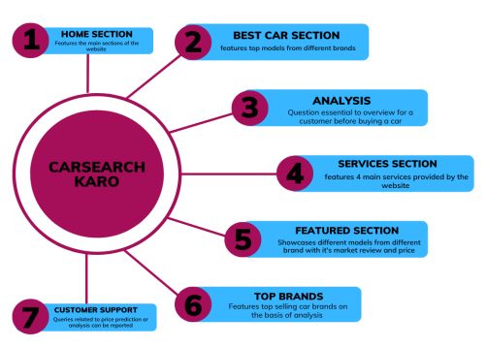
Website flow
Quality
Auto Services

Slide 13
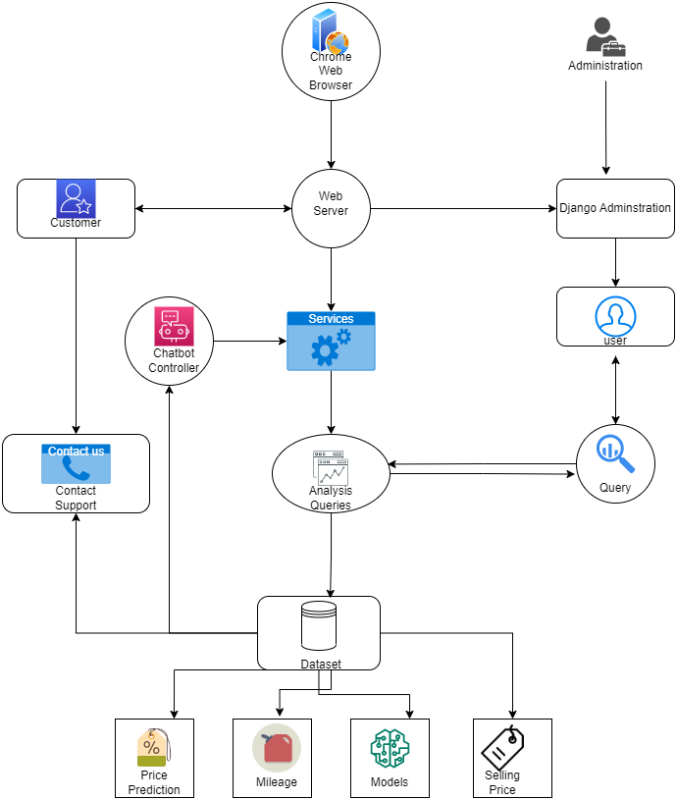
System Architecture Diagram:
Quality Auto Services

Slide 14

Tech stack details

Slide 15
Front-End: Django, HTML, CSS, JavaScript, Bootstrap
Back-End: Python, machine learning model
Database: Django admin panel ,SQL-Lite, car dataset (csv)

Slide 16
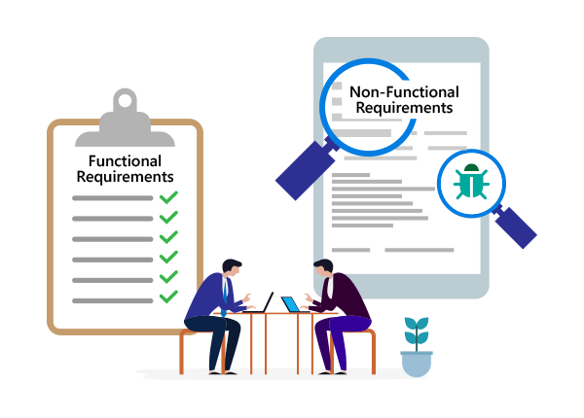
Requirements Analysis

Slide 17
System Requirements
Requirement | Minimum | Recommended
RAM | 4 GB of free RAM | 8 GB of total System RAM
CPU | Any modern CPU | Multi-core CPU. Pycharm supports multithreading for different operations and processes making it faster the more CPU cores it can use
Disk Space | 2.5 GB and another 1GB for caches | SSD drive with atleast 5GB of free space
Operating system | Officially released 64-bit versions of the following: Microsoft Windows 8 or later macOS 10.14 or later Any Linux distribution that supports Gnome, KDE , or Unity DE. PyCharm is not available for some Linux distributions, such as RHEL6 or CentOS6, that do not include GLIBC 2.14 or later. Pre-release versions are not supported. | Latest 64-bit version of Windows, macOS, or Linux (for example, Debian, Ubuntu, or RHEL)

Slide 18

Software requirements
Python 3: from the version 3.6 up to the version 3.11
PyCharm cross-platform IDE
Django Web Framework
Dataset

Slide 19

Proposed system

Slide 20

Features
1.Progressive web app
2. responsive and dynamic website
3. Cost-efficient
4. Modern Data Analysis
5. Pleasing and accurate data visuals
6. Use of Django panel for customer queries database
7. Transparent price prediction mechanism through machine learning.
8. chatbot provides quick overview of car market trends and general queries.

Slide 21
Future enhancements :
1. Top brands and the car in featured section. These are the static part of the website.
2.We will try to make these sections dynamic and improve the website further.
3. For now only 8 questions are added to the website as it is a prototype.
4. We will try to add more frequently asked questions on the website.

Slide 22
Conclusion
We have successfully developed a customer delight platform which provides you with the precise car suggestion and answers the frequently asked questions with data visuals using charts and bar graphs.
Also developed a price prediction ML model which helps the customer to plan the budget.

Slide 23
References
https://www.cardekho.com
https://www.zigwheels.com/newcars/find-your-perfect-car

